Slide 1



ATTITUDE

Slide 2

Can be your best friend or your worst enemy
One factor that can destroy the benefits of every possible advantage

Slide 3
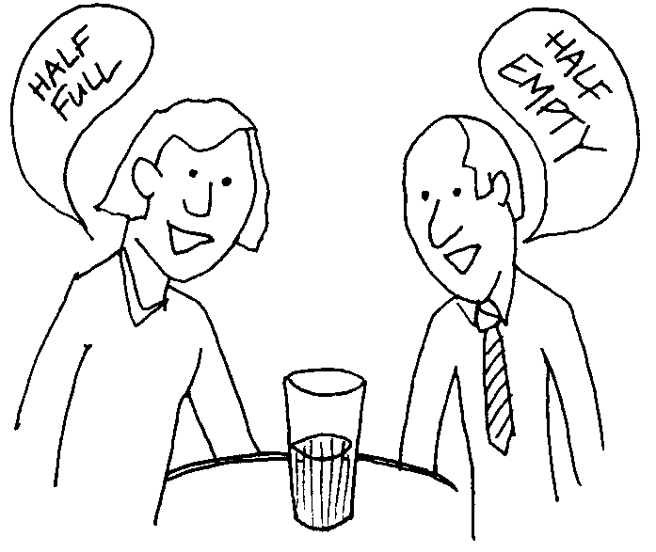
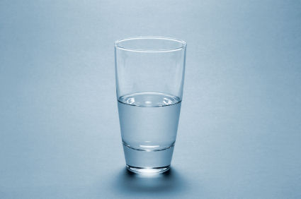
Associated with physical neural state, verbal opinion, ideologies and integrated philosophy of life
Nothing but how one feels about somebody or something

Slide 4
Meaning:
Mental and neural stage of readiness organized through experience exerting a dynamic influence upon the individual’s response to all situations and objects with which he is related

Slide 5

Attitude is a “learned predisposition towards aspects of our environment”

Slide 6
An attitude can be defined as a positive or negative evaluation of people, objects, event, activities, ideas, or just about anything in your environment (Zimbardo et al., 1999)
In the opinion of Bain (1927), an attitude is "the relatively stable overt behavior of a person which affects his status."

Slide 7
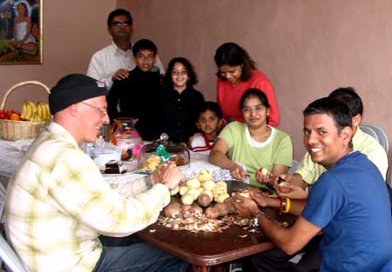
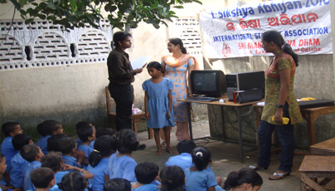
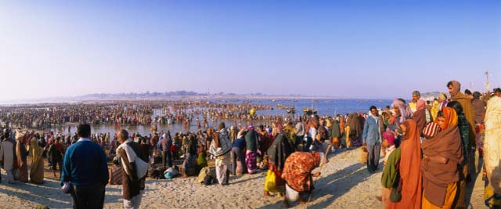
Features of Attitudes
Multiplexity: -
  Constituted by a number of elements – mainly ingredients in the formation of attitudes…
Family
Environment
Society

Slide 8

Relations to needs:
Attitudes vary in relation to the needs they serve…
Attitudes of a person towards sports and games may serve only entertainments needs of favourableness or unfavourableness towards something or somebody…

Slide 9
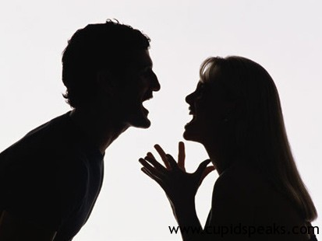
Valence: (Chemistry) – relationship bet. Two…
  Refers to the magnitude; could be low or high
  Low valence: a person has an indifferent attitude towards something or somebody
  High valence: a person having extremely favourable or unfavourable attitude towards something or somebody

Slide 10
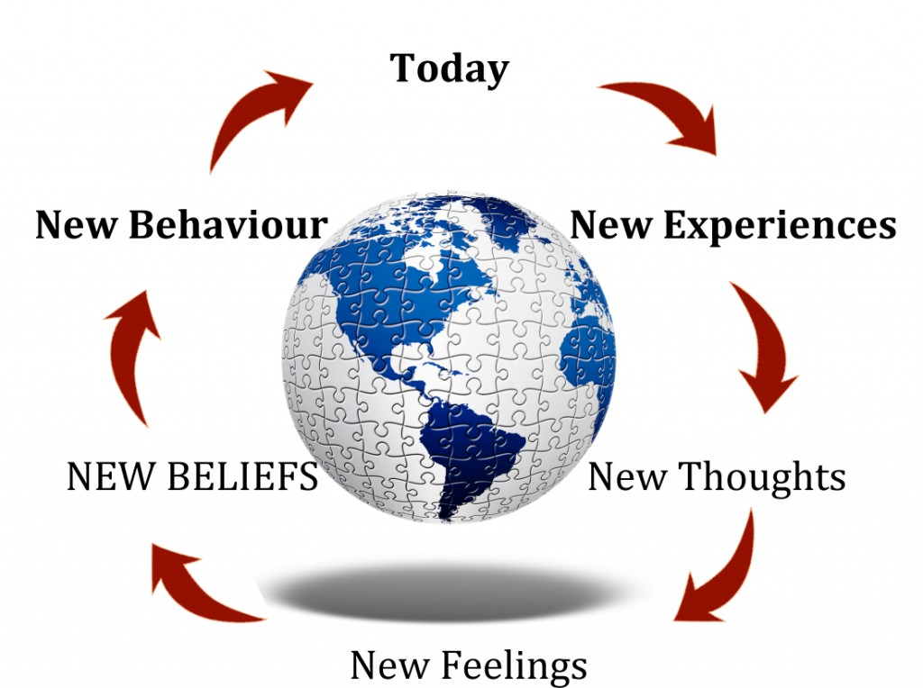
Related to feelings and beliefs:
  Related to one’s feelings and beliefs towards something or somebody

Slide 11
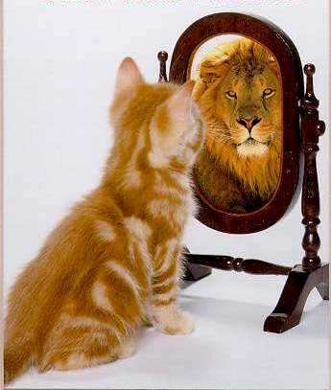
Attitudes affect behaviour:
  Affect behaviour either positively or negatively because attitudes affect one’s perceptions

Slide 12
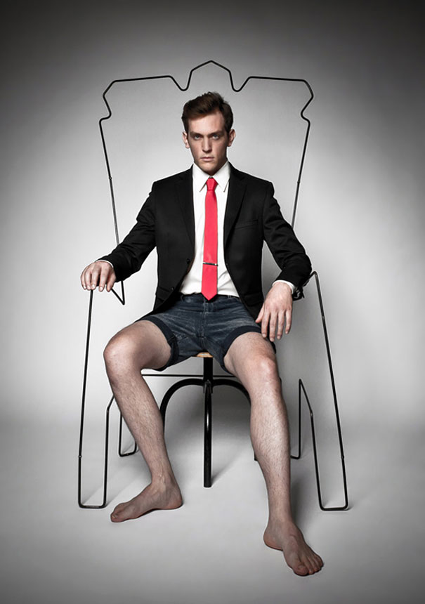
Attitudes undergo changes:
  Generally speaking attitudes remain in a person for a longer duration. But the same can undergo changes if persons are exposed to different situation they like

Slide 13

Power of positive attitude:
We of thinking affects all aspects of your life
P A helps to cope more easily with the daily affairs
Makes it easier to avoid worry and negative thinking
Being constructive changes into your life & make you happier, brighter and more successful

Slide 14
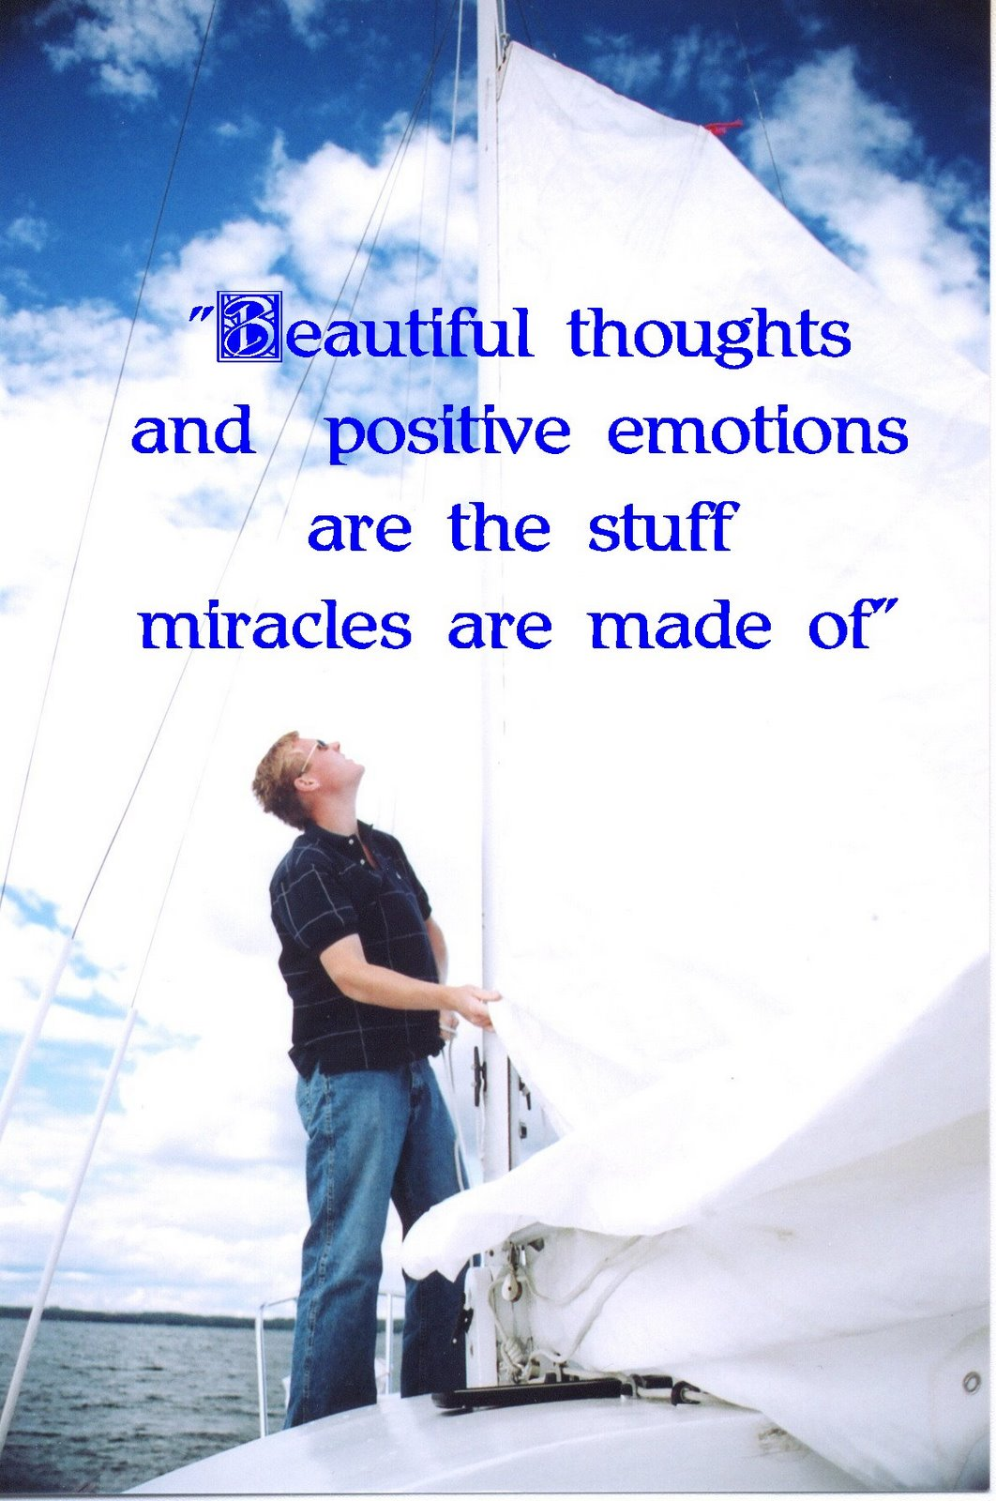
P A manifests
Positive thinking
Constructive thinking
Creative thinking
Expecting success
Being inspired
Not giving up
Looking for solutions
Seeing opportunities

Slide 15
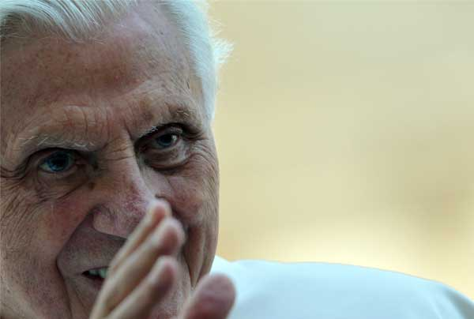
Obstacles in developing P A
Exaggerating:
I am always late to the Class
I make it to most class on time

Slide 16

Over generalizing:
I am stupid
This time I made a wrong turn

Slide 17
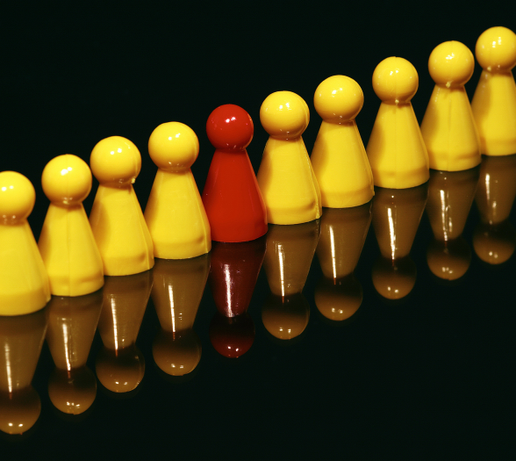
Personalizing:
Everyone noticed that I wore the same dress twice
I like this outfit, and I am properly dressed for the occasion

Slide 18
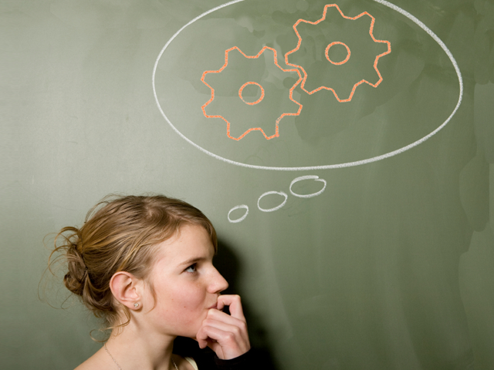
Thinking:
  Either I get the promotion or I am a failure
  My performance has been exceptional, and I have a good chance

Slide 19
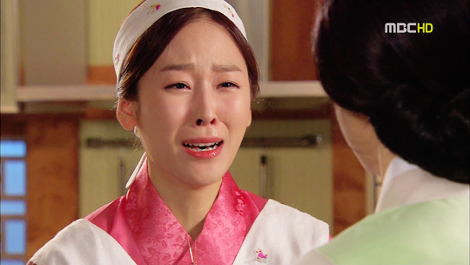
Jumping to Conclusion:
  I wasn’t’ assigned the project because I wasn’t at my desk when my manager called
  I will ask my manger if there is a way I can help out with the assignment

Slide 20
Developing Positive Attitude
  Listen to internal dialogue
  Learn to communicate
  Get back to basics
  Help someone out
  Find your spirituality
  Allow yourself to be loved
  Allow yourself to laugh and find humour in the simplest of thinking
  Participate in new physical and mental activities
  Follow the principles of holistic health

